Slide 1
SCALING AND ROOT PLANING

Slide 2
LEARNING OBJECTIVES
Classification of periodontal instruments
General principles of periodontal instrumentation
Principles of scaling and root planing
Instrument sharpening

Slide 3
CLASSIFICATION OF PERIODONTAL INSTRUMENTS according to the purpose
Periodontal probe
Explorers
Scaling, root planing and curettage instruments.
Sickle scalers
Curettes
Hoe, Chisel and file scalers
Ultrasonic and Sonic instruments.
Periodontal endoscope.
Cleansing and Polishing instruments.

Slide 4
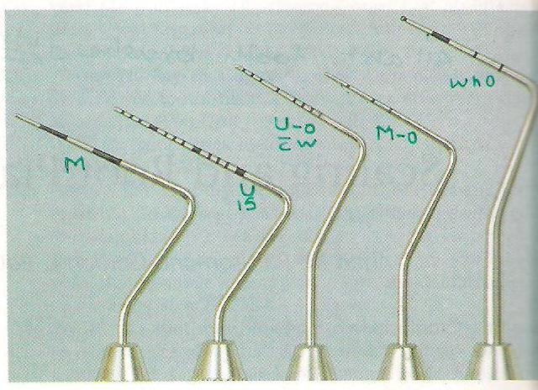
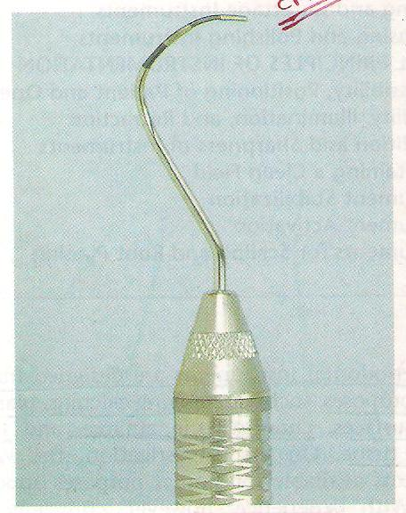
PERIODONTAL PROBES
Used to locate, measure and mark pocket as well as determine their course on individual tooth surface.
Types
UNC 15 probe
Marquis color coded probe
Michigan O probe
Michigan O probe with Williams marking
WHO probe
Nabers probe

Slide 5
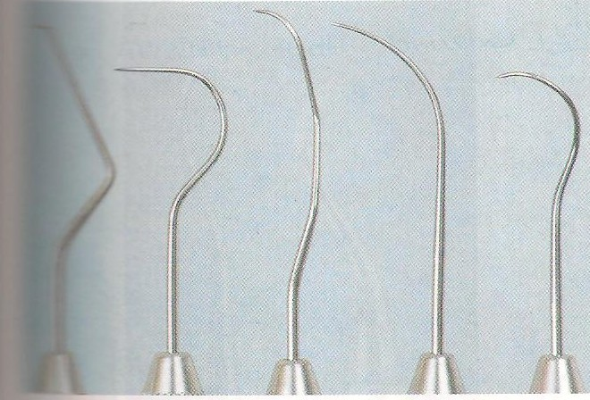
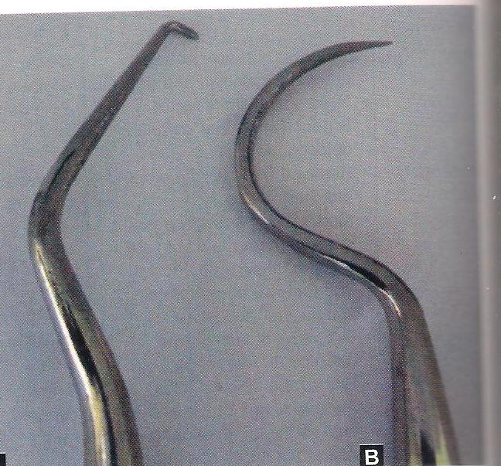
EXPLORERS
Are used to locate subgingival deposits and carious areas and to check the smoothness of the root surface after root planing.

Slide 6
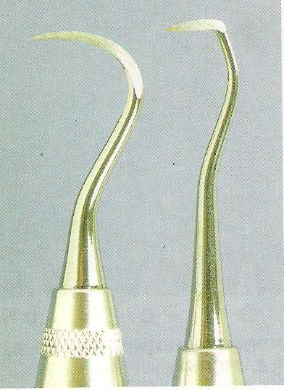
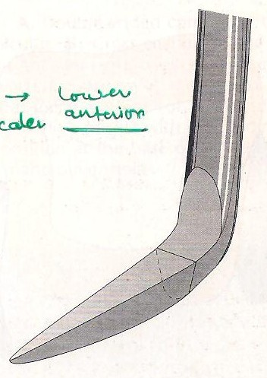
SCALING AND CURETTAGE INSTRUMENTS
Sickle scalers (supragingival scalers)
Have flat surface and two cutting edges that converge in a sharply pointed tip.
Triangular shape, double cutting edge.
Used primarily to remove supragingival calculus.
Used with pull stroke.
Straight shank- anteriors and premolars
Contra angled shank- posteriors

Slide 7
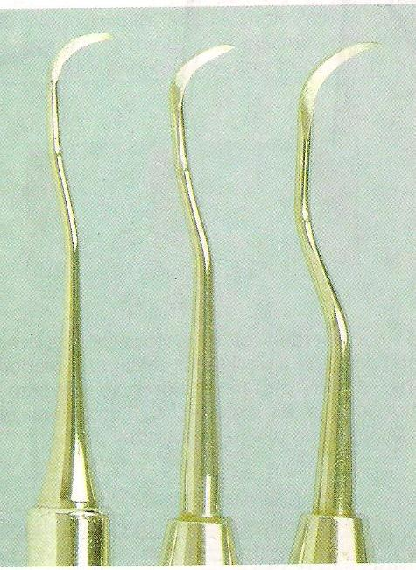
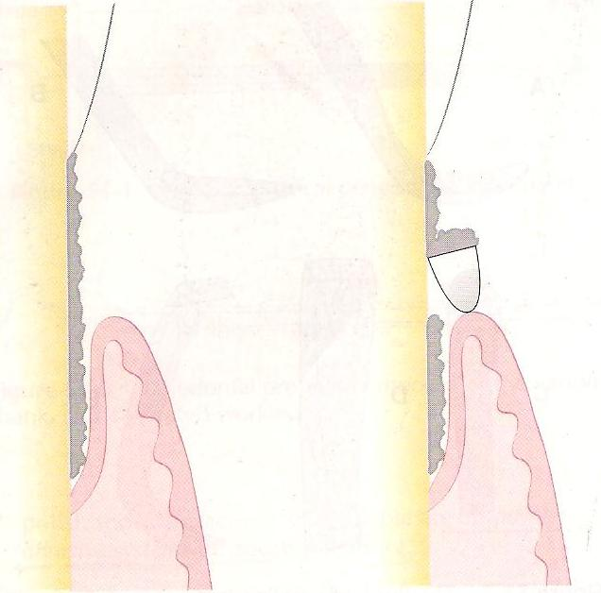
Sickle scalers (supragingival scalers)

Slide 8
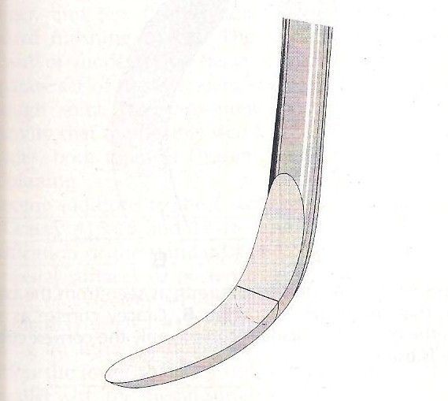
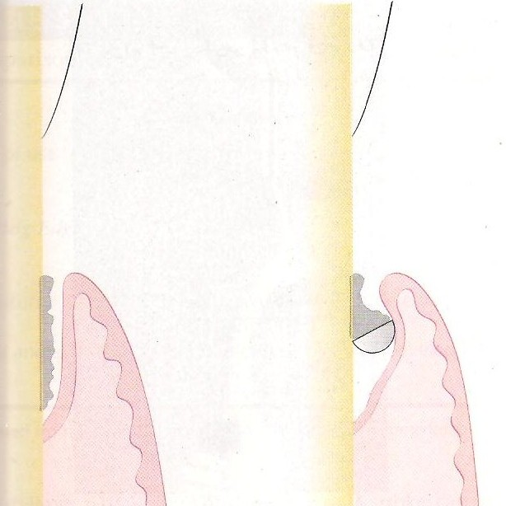
Curettes (spoon shaped blade with rounded tip)
Instrument of choice of deep subgingival calculus, root planing altered cementum and removing the soft tissue lining of periodontal pocket.
Each working end has a cutting edge on both the sides of blade and rounded toe.

Slide 9
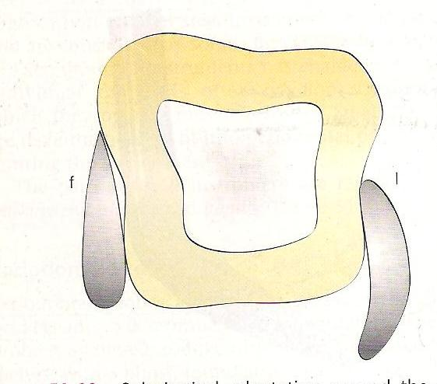
The curette is finer than sickle scalers and does not have any sharp points or corners other than cutting edges of the blade so, curettes can be adapted and provide good access to the deep pockets with minimal soft tissue trauma.
In cross section the blade appears semicircular with a convex base.

Slide 10
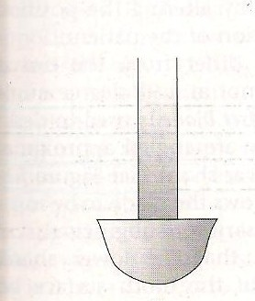
Universal curette (2R-2L, 4R-4L)
Have cutting edge that may be inserted in most areas of dentition by altering and adapting the finger rest, fulcrum and hand position of operator.
Blade is at 90* angle to the lower shank (i.e. blade is not offset).
Blade is curved in one plane. (i.e. curved up, not to the side).
Both cutting edge is used (i.e. work with either outer or inner edge).

Slide 11
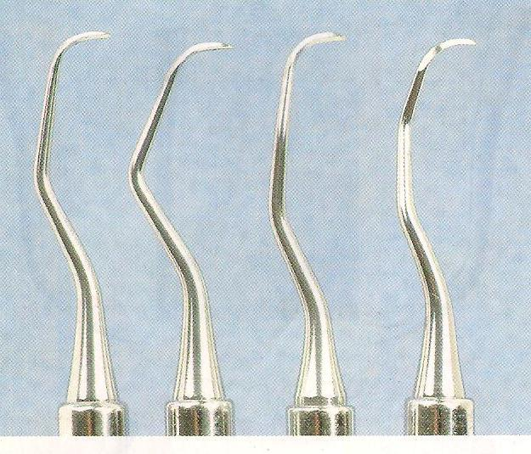
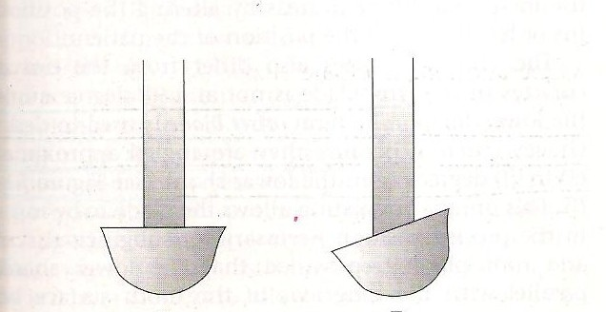
Area specific curette (Gracy curette)
Best instruments for subgingival scaling and root planing because they provide best adaptation to complex root anatomy.
Set of many curettes designed for specific areas and surfaces.
One cutting edge used; work with outer edge only
Offset blade- face of blade beveled at 60* to the shank.

Slide 12
Double ended curette are paired In following manner
Gracy 1-2 & 3-4 anterior teeth
5-6 anterior and premolars
7-8 & 9-10 posterior facial and lingual
11-12 posterior mesial
13-14 posterior distal
Modifications
15-16 modification of 11-12
(blade -11-12 & shank 13-14)
17-18 modification of 13-14
(terminal shank elongated by 3mm to provide complete occlusal clearance and better access)

Slide 13
THANK YOU

Slide 14
Q.1. Furcation is best detected by which probe
WHO Probe
Michigan Probe
Marquis color coded Probe
Naber’s Probe

Slide 15
Q.2. Cross-section of sickle scaler is
Triangular
Half circular
Circular
oval

Slide 16
Q.3. Gracy curette no. 11-12 are used for;
Anterior teeth
Posterior teeth mesial surface
Posterior teeth distal surface
Posterior teeth facial and lingual surface

Slide 17
Q.2. The millimeter markings that are missing in Williams probe:
1 and 3
4 and 6
7 and 9
10 and 12

Slide 18
Q.5. Which of the following Gracy curettes is meant for facial and lingual surface of posterior teeth:
9-10
11-12
13-14
15-16

